Slide 1
Chapter 6: Constraint Satisfaction Problems
These slides are adopted from Berkeley course materials and Russell and Norvig textbook

Slide 2
Announcement
The midterm exam will be on Thursday 1 December, at 11 am.

Slide 3
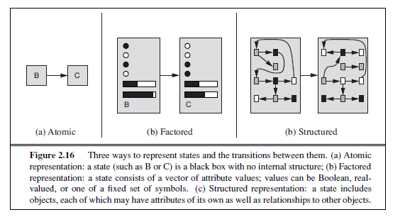
Constraint Satisfaction Problems
Standard search problems studied so far use atomic states (a black box with no internal structure.)
Constraint satisfaction problems are a special kind of search problems that use a factored representation for the state space.
For each state: there is a set of variables, each of which has a value.
A problem is solved when each variable has a value that satisfies all the constraints on the variables.

Slide 4
Constraint Satisfaction Problems
A constraint satisfaction problem consists of three components: X,D, and C:
X is a set of variables, {X1, . . . ,Xn}.
D is a set of domains, {D1, . . . ,Dn}, one for each variable.
C is a set of constraints that specify allowable combinations of values.
Allows useful general-purpose algorithms with more power than standard search algorithms.
The main idea is to eliminate large portions of the search space all at once by identifying variable/value combinations that violate the constraints.
Notes:
Goal test has structure, it ‘s more like a manual describing a set of constraints that have to hold true

Slide 5
Constraint Satisfaction Problems
Each state in a CSP is defined by an assignment of values to some or all of the variables, {Xi =vi,Xj = vj , . . .}.
A consistent assignment is an assignment that does not violate any constraints.
A complete assignment is one in which every variable is assigned.
A solution to a CSP is a consistent, complete assignment.
A partial assignment is one that assigns values to only some of the variables.

Slide 6
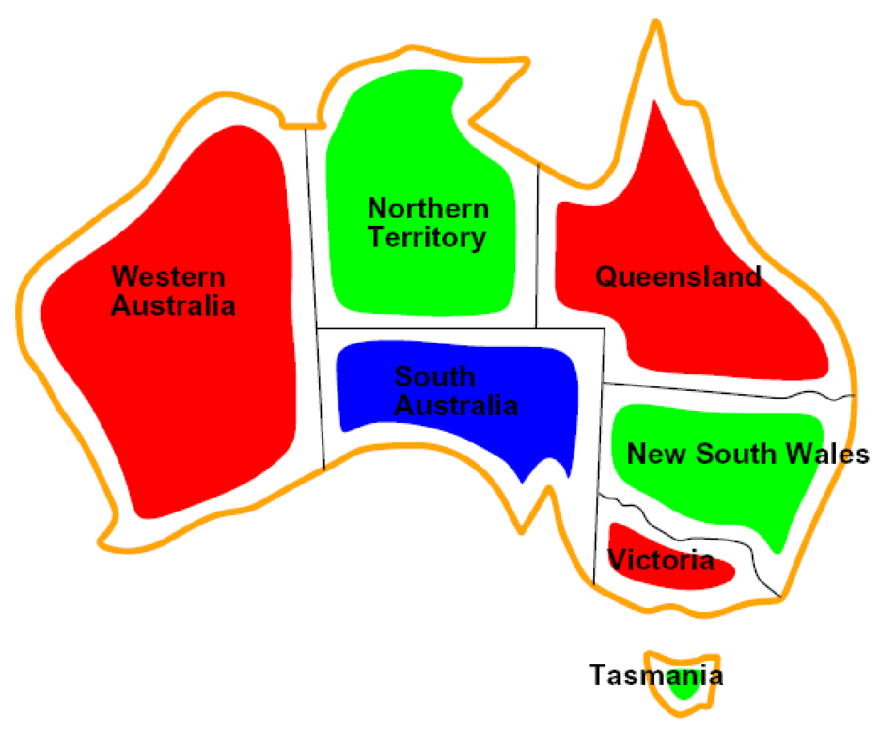
CSP Examples: Map coloring

Slide 7


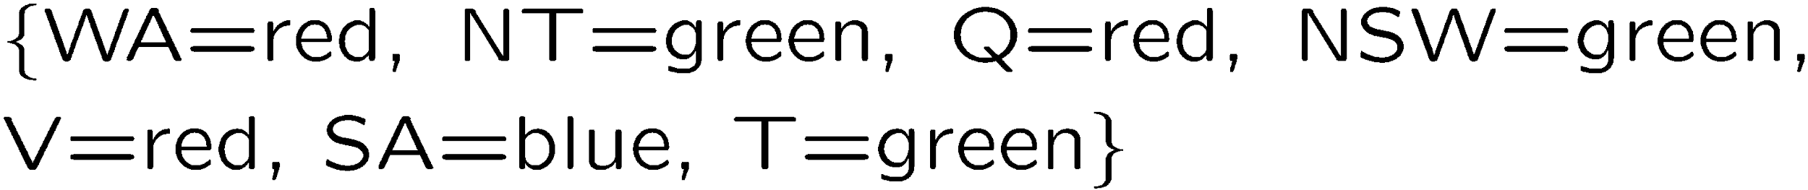
Example: Map Coloring
Variables:
Domains:
Constraints: adjacent regions must have different colors
Solutions are assignments satisfying all constraints, e.g.:
Implicit:
Explicit:

Slide 8
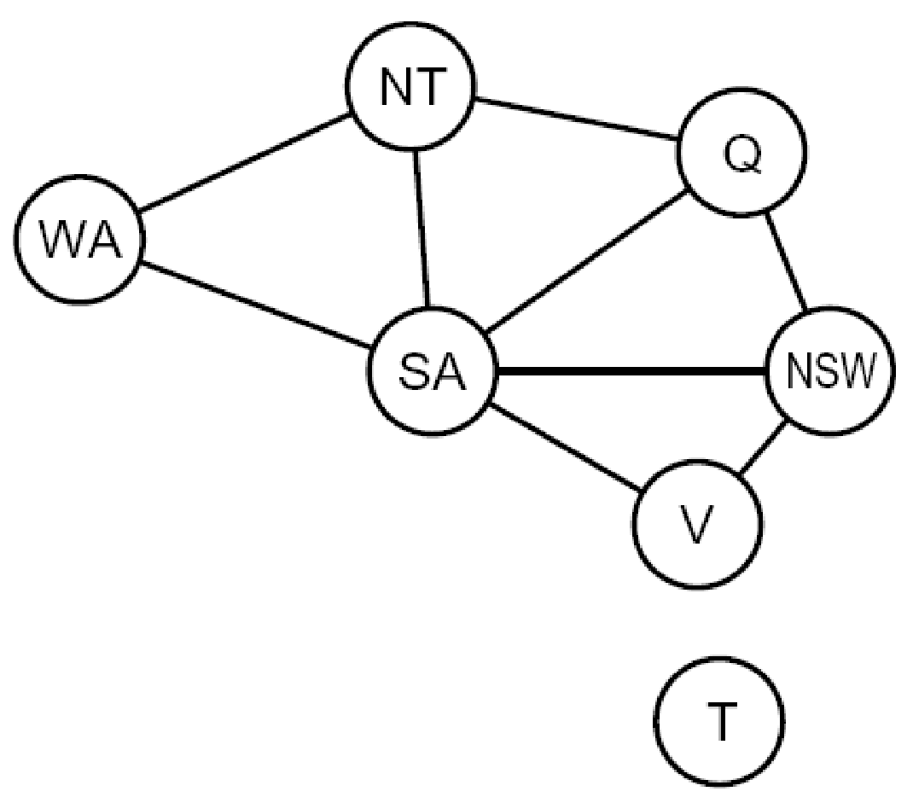
Constraint Graphs
Binary CSP: each constraint relates (at most) two variables.
Binary constraint graph: nodes are variables, arcs show constraints.
General-purpose CSP algorithms use the graph structure to speed up search. E.g., Tasmania is an independent subproblem!

Slide 9
Why formulate the problem as a CSP?
CSP solvers can be faster than state-space searchers because the CSP solver can quickly eliminate large portions of the search space.
For example, assume {SA=blue} in the Australia map coloring problem, we can conclude that none of the five neighboring variables can take on the value blue.
Without taking advantage of constraint propagation, a search procedure
would have to consider 3⁵ =243 assignments for the five neighboring
variables.
With constraint propagation we never have to consider
blue as a value, so we have only 2⁵ =32 assignments to look at,
a reduction of 87%.

Slide 10
Why formulate the problem as a CSP? (cont.)
With CSPs, once we find out that a partial assignment is not a solution, we can immediately discard further refinements of the partial assignment.

Slide 11
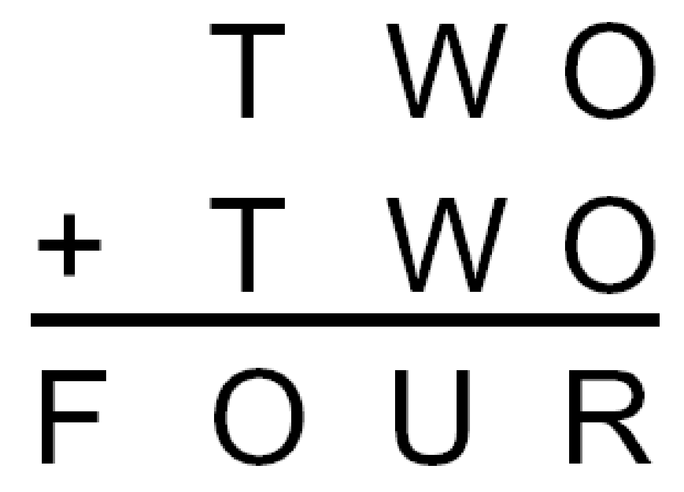
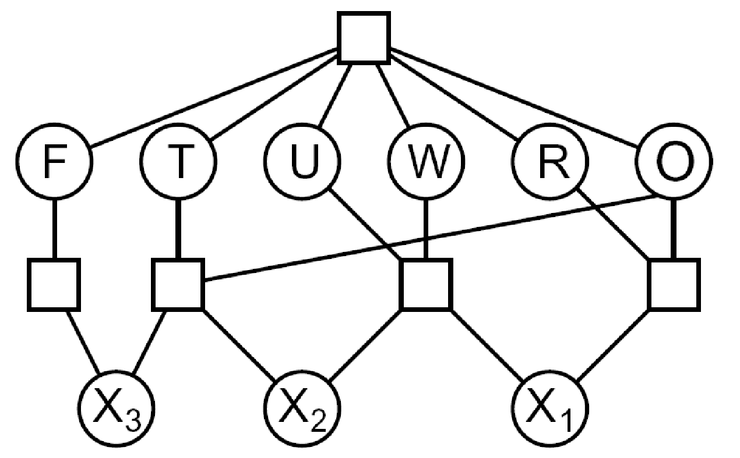

Example: Cryptarithmetic
Variables:
Domains:
Constraints:
Notes:
0=7, R=4, W=6, U=2, T=8, F=1; 867 + 867 = 1734

Slide 12
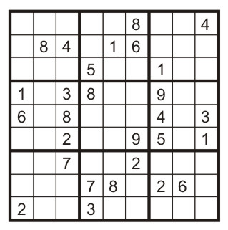
Example: Sudoku
Variables:
Each (open) square
Domains:
{1,2,…,9}
Constraints:
9-way alldiff for each column
9-way alldiff for each row
9-way alldiff for each region
(or can have a bunch of pairwise inequality constraints)

Slide 13


Varieties of CSPs
Discrete Variables
Finite domains
Size d means O(d^{n}) complete assignments
E.g., Boolean CSPs, including Boolean satisfiability (NP-complete)
Infinite domains (integers, strings, etc.)
E.g., job scheduling, variables are start/end times for each job
Linear constraints solvable, nonlinear undecidable
Continuous variables
E.g., start/end times for Hubble Telescope observations
Linear constraints solvable in polynomial time by Linear Programming methods
Notes:
linear programming problems, where constraints
must be linear equalities or inequalities. Linear programming problems can be solved
in time polynomial in the number of variables

Slide 14


Varieties of Constraints
Varieties of Constraints
Unary constraints involve a single variable (equivalent to reducing domains), e.g.:
Binary constraints involve pairs of variables, e.g.:
Higher-order constraints involve 3 or more variables:
e.g., cryptarithmetic column constraints
Preferences (soft constraints):
E.g., red is better than green for a certain city in Australia map coloring or Prof. A prefers his lecture in the morning.
Often representable by a cost for each variable assignment

Slide 15
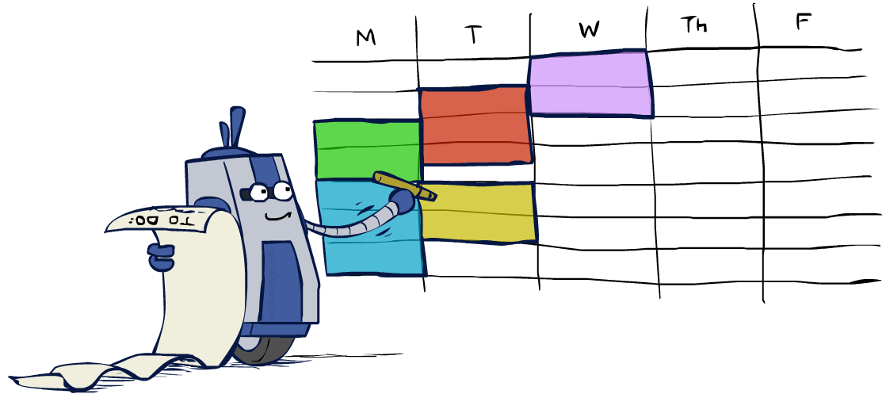
Real-World CSPs
Assignment problems: e.g., who teaches what class
Timetabling problems: e.g., which class is offered when and where?
Hardware configuration
Transportation scheduling
Factory scheduling
Circuit layout
Fault diagnosis
… lots more!
Many real-world problems involve real-valued variables…

Slide 16

Standard Search Formulation
Standard search formulation of CSPs
States defined by the values assigned so far (partial assignments)
Initial state: the empty assignment, {}
Successor function: assign a value to an unassigned variable.
Goal test: the current assignment is complete and satisfies all constraints.
We’ll start with the straightforward, naïve approach, then improve it.

Slide 17
Standard Search Algorithms
Assume a CSP problem with n variables, each of domain size d.
The branching factor at the top level is nd because any of d values can be assigned to any of n variables.
At the next level, the branching factor is (n − 1)d, and so on for n levels.
We generate a tree with n!d^{n} leaves, even though there are only d^{n} possible complete assignments!
Can we improve this?
Yes, exploit CSP commutativity.
CSPs are commutative because the order of assigning values to variables does not change the outcome (the partial assignment).
For example, [WA = red then NT = green] is the same as [NT = green then WA = red]
Therefore, we need only consider a single variable at each node in the search tree (number of leaves would be d^{n} ).

Slide 18
Backtracking Search for CSP
Shall you choose BFS or DFS for solving a CSP problem?
Backtracking search is a depth-first search with two improvements for using in CSP:
It chooses values for one variable at a time and backtracks when a variable has no legal values left to assign.
It checks the constraints by considering only values which do not conflict previous assignments
Might have to do some computation to check the constraints
“Incremental goal test”

Slide 19
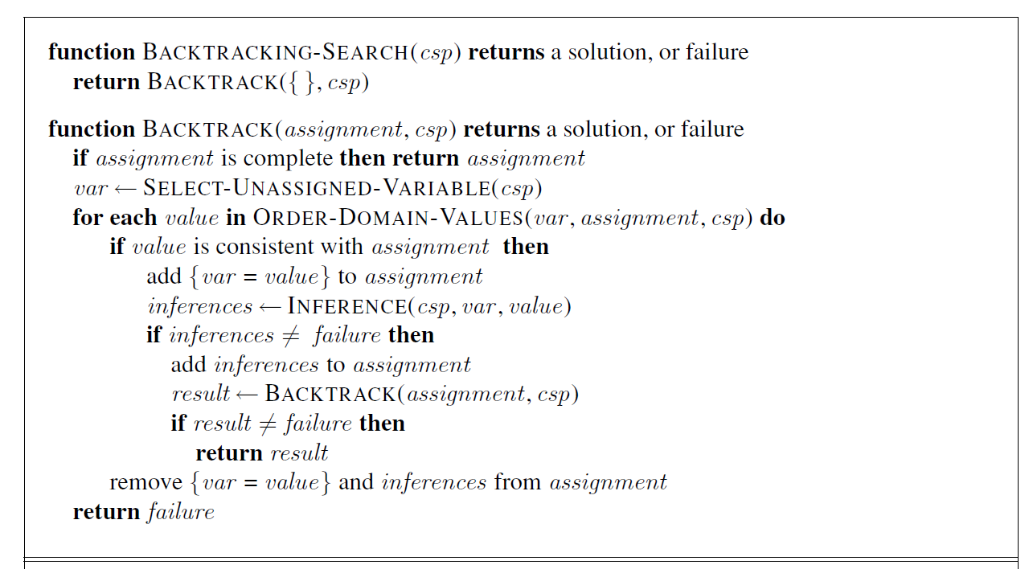
Backtracking Search Algorithm
Notes:
It repeatedly chooses an unassigned variable, and then tries
all values in the domain of that variable in turn, trying to find a solution. If an inconsistency is
detected, then BACKTRACK returns failure, causing the previous call to try another value

Slide 20
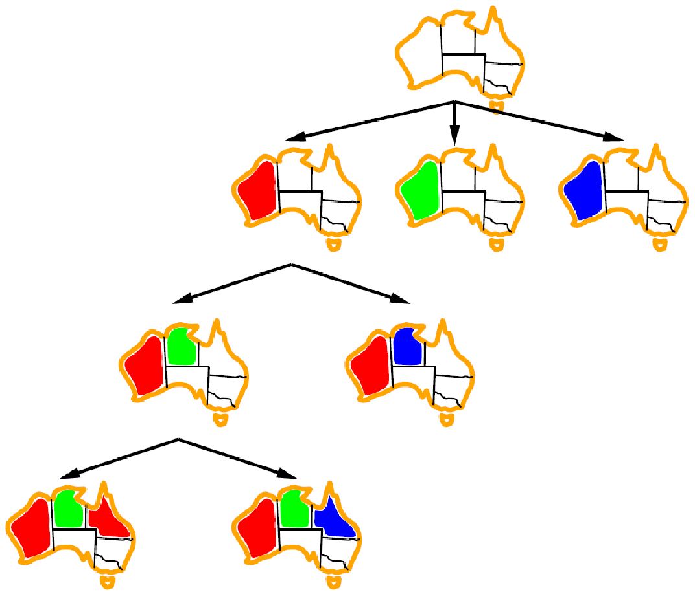
Backtracking- map coloring example

Slide 21
Improving Backtracking
Ordering
Which variable should be assigned next ?
What order should its values be tried?
Inference
Can we detect failures earlier?
Notes:
In Chapter 3 we improved the poor performance of uninformed search algorithms by
supplying them with domain-specific heuristic functions derived from our knowledge of the
problem. It turns out that we can solve CSPs efficiently without such domain-specific knowledge.

Slide 22

Variable Ordering
Variable Ordering: Minimum remaining values (MRV):
Choose the variable with the fewest legal left values in its domain
Why min rather than max?
Also called “most constrained variable”
“Fail-fast” ordering as it picks a variable that is most likely to cause a failure soon, thereby pruning the search tree.
The MRV heuristic usually performs better than a random or static ordering.
Notes:
If some variable X has no legal values left, the MRV
heuristic will select X and failure will be detected immediately—avoiding pointless searches
through other variables.

Slide 23
Variable Ordering
The MRV heuristic doesn’t help in choosing the first region to color in Australia (each region has three possible colors).
Degree Heuristic:
Choose the variable with the highest degree in the constraint search graph
The degree heuristic selects the variable involved in the largest number of constraints on other unassigned variables.
In the map coloring example, which variable to choose at first according to the degree heuristic?
Notes:
, SA is the variable with highest degree, 5; the other variables have degree 2 or 3,
except for T, which has degree 0

Slide 24
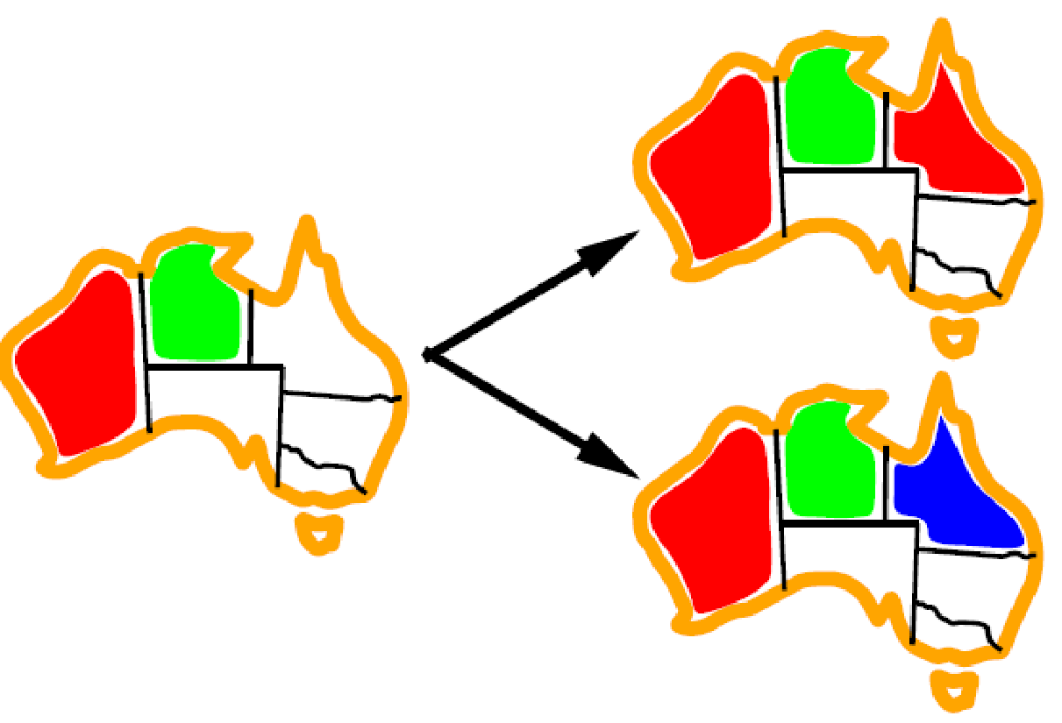
Value Ordering
Which value shall we choose for coloring Q red or blue? Why?
Value Ordering: Least Constraining Value
Given a choice of variable, choose the least constraining value
I.e., the one that rules out the fewest values in the remaining variables
Note that it may take some computation to determine this!
Why least rather than most?
To leave the maximum flexibility for subsequent variable assignments.
Combining these ordering ideas makes
1000 queens feasible
NT
Q
WA
SA
NSW
NT
V
WA
Q
SA
NSW
V
NT
WA
Q
SA
NSW
V
Notes:
For example, suppose that in Figure 6.1 we have generated the partial
assignment with WA=red and NT =green and that our next choice is for Q. Blue would
be a bad choice because it eliminates the last legal value left for Q’s neighbor, SA. The
least-constraining-value heuristic therefore prefers red to blue.

Slide 25
Constraint Propagation
In regular state-space search, an algorithm can do only one thing: search.
In CSPs, an algorithm can search (choose a new variable assignment from several possibilities) or do a specific type of inference called constraint propagation.
Constraint propagation is using the constraints to reduce the number of legal values for a variable, which in turn can reduce the legal values for another variable, and so on.
Constraint propagation may be done with search, or as a preprocessing step, before the search.
Sometimes this preprocessing can solve the whole problem, so no search is required at all!

Slide 26
Inference: Forward Checking
Constraint Propagation
Using the constraints to reduce the number of legal values for a variable, which in turn can reduce the legal values for another variable, and so on.
Forward checking:
For each unassigned variable Y that is connected to X by a constraint, delete from Y ’s domain any value that is inconsistent with the value chosen for X.
Notes:
of a value for a variable, we have a brand-new
opportunity to infer new domain reductions on the neighboring variables

Slide 27
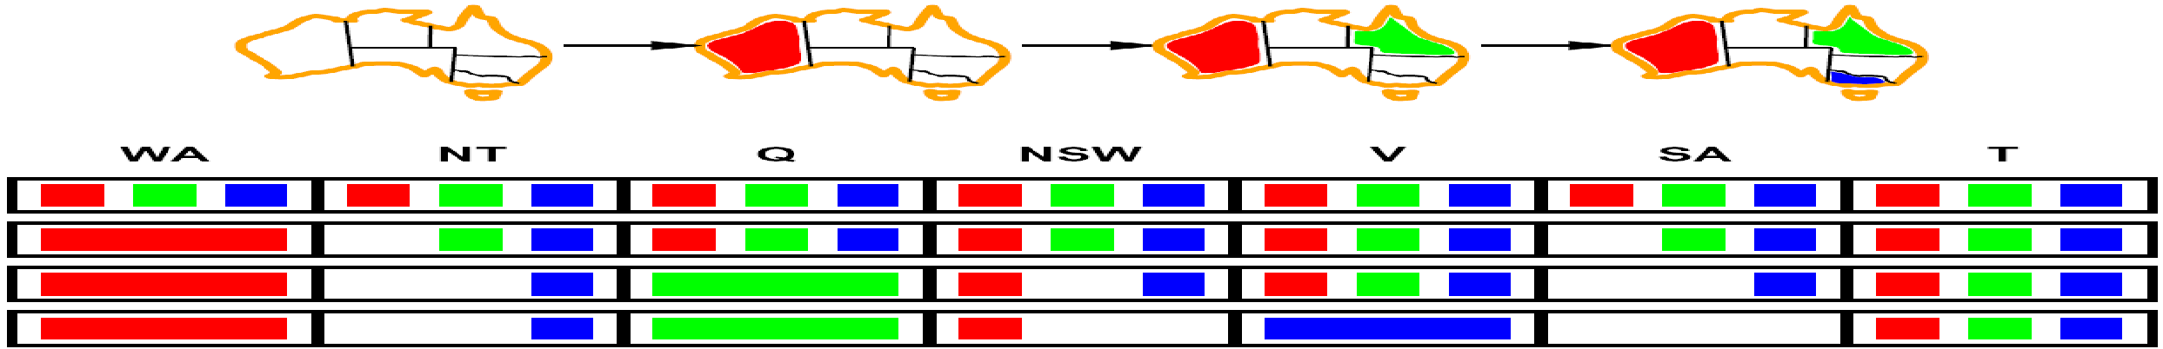
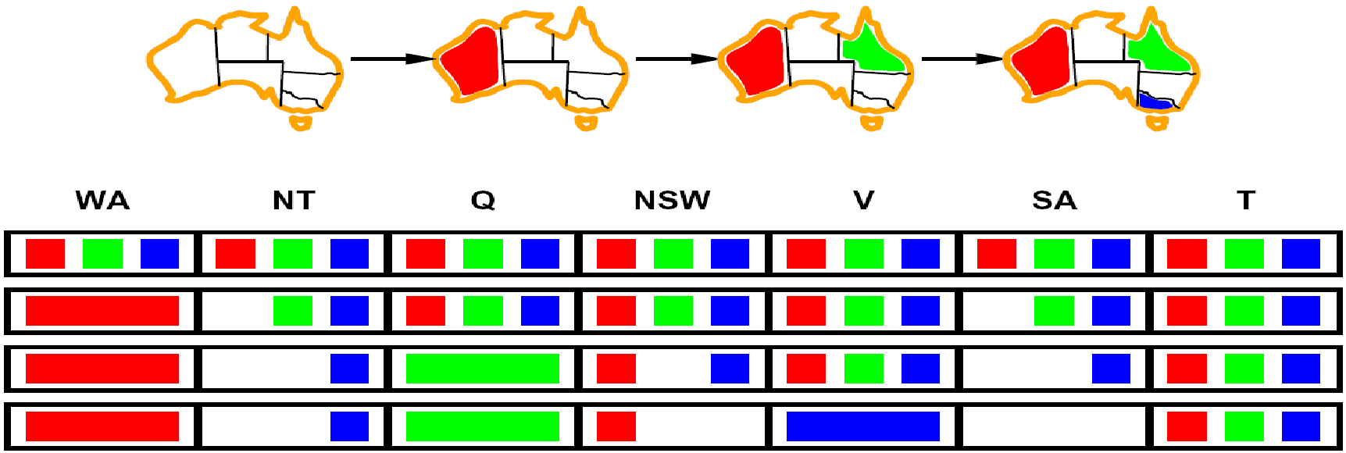
Inference: Forward Checking Example
WA
NT
Q
SA
NSW
V
[Demo: coloring -- forward checking]

Slide 28
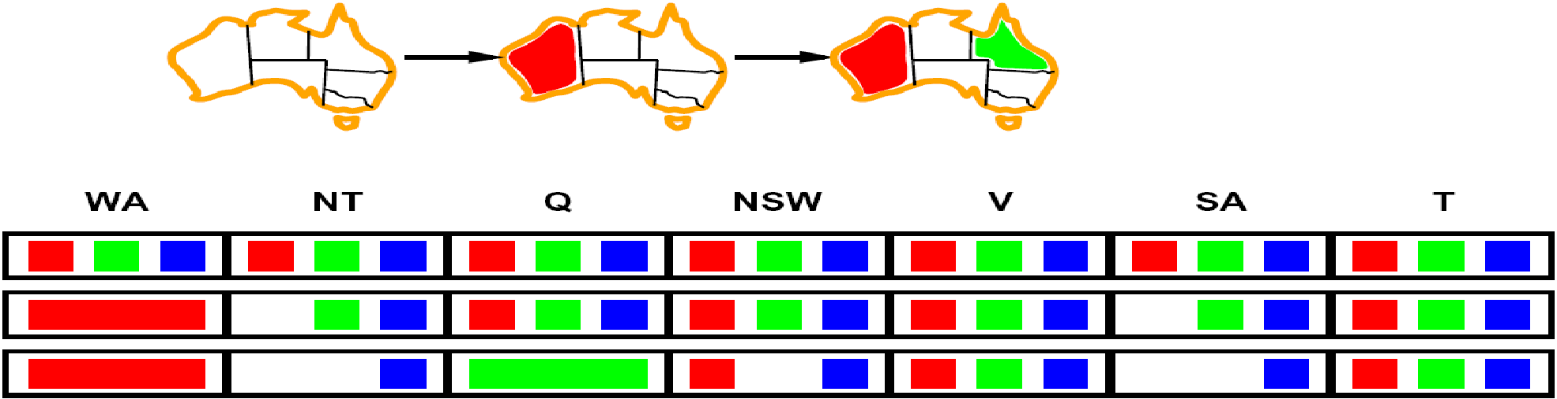
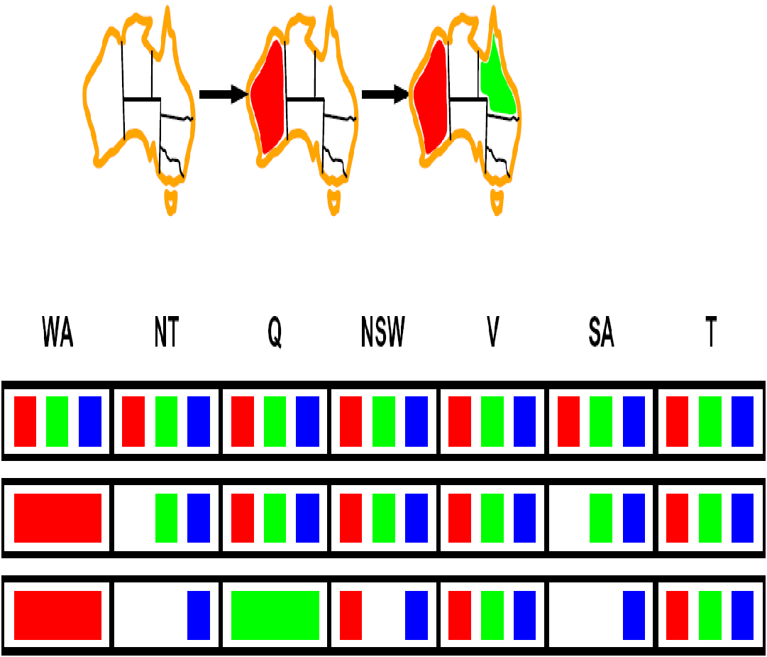
Forward Checking Example (cont.)
Forward checking propagates information from assigned to unassigned variables, but doesn't provide early detection for all failures:
NT and SA cannot both be blue!
Why didn’t we detect this yet?
Constraint propagation: reason from constraint to constraint
NT
Q
WA
SA
NSW
V
Notes:
We’ve already failed, but forward checking does not detect that.
Forward checking shows that when WA is red and Q is green, both NT and SA are forced to be blue. Forward
checking does not look far enough ahead to notice that this is an inconsistency: NT and SA
are adjacent and so cannot have the same value.

Slide 29
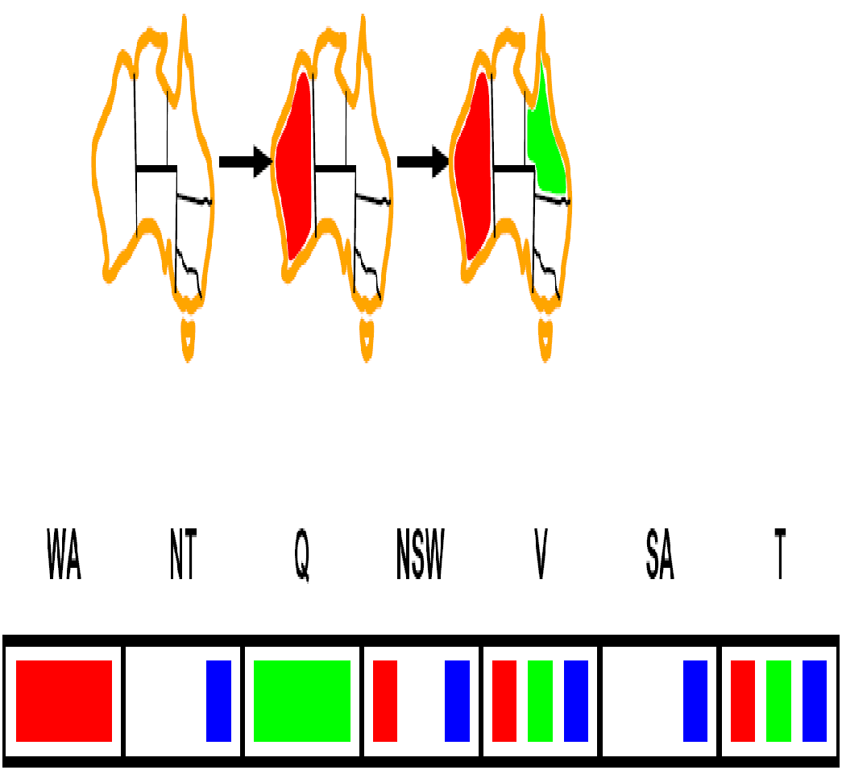
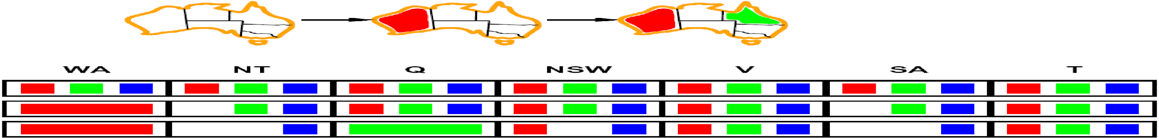


Constraint Propagation: Arc Consistency
An arc X → Y is consistent iff for every x in the tail there is some y in the head which could be assigned without violating a constraint.
Forward checking?
Enforcing consistency of arcs pointing to each new assignment (Y->X) if Y is an unassigned variable, and X is the newly assigned variable.
NT
Q
WA
SA
NSW
V
Delete from the tail!
Notes:
Mnemonic – csp police checks my trunk

Slide 30

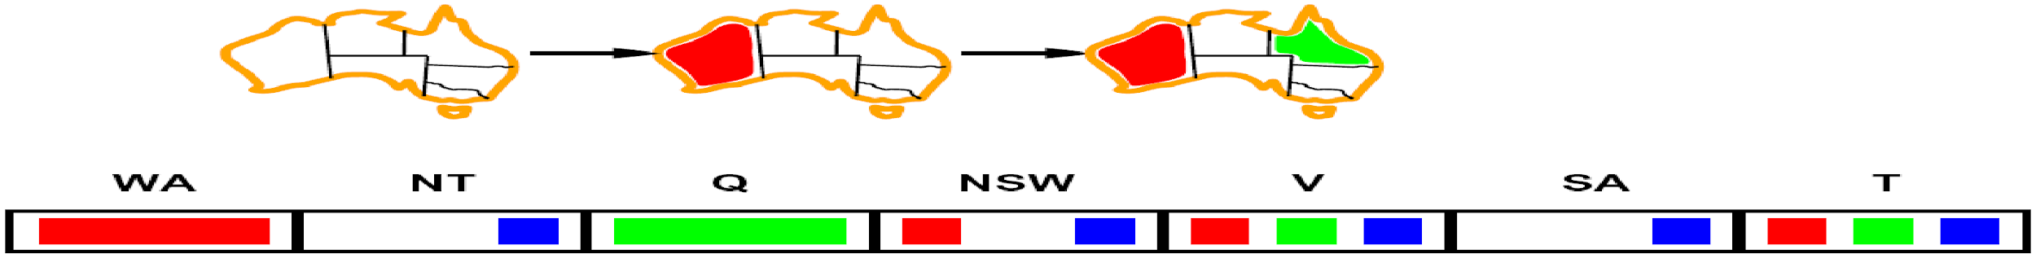
Arc Consistency of an Entire CSP
A simple form of propagation makes sure all arcs are consistent:
Important: If X loses a value, neighbors of X need to be rechecked!
Arc consistency detects failure earlier than forward checking.
Can run as a preprocessor (before the search) or after each assignment.
What’s the downside of enforcing arc consistency?
NT
Q
WA
SA
NSW
V
Remember: Delete from the tail!
Notes:
reminds you of a* - heuristic takes time

Slide 31
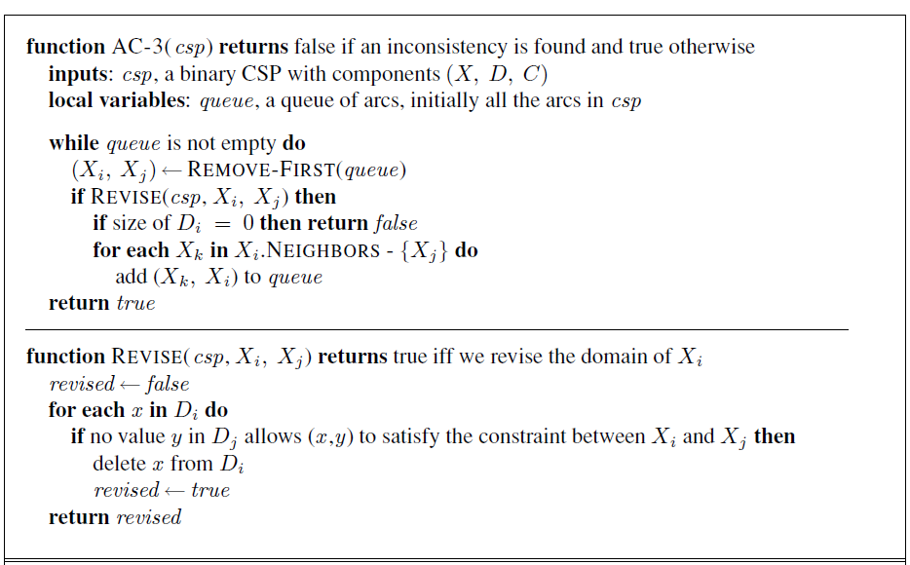
Arc Consistency Algorithm in CSP
Runtime: O(cd³), c is number of constraints and d is the domain size.
Notes:
Auto-consistency (note initially nothing gets deleted/pruned since there are consistent options for all constraints for initial variable domains)
Arc can be inserted d times
Each arc (Xk,Xi) can be inserted in the queue only d times because Xi has at most d values to delete
Checking consistency of a single arc d^2

Slide 32


Limitations of Arc Consistency
After enforcing arc consistency:
Can have one solution left
Can have multiple solutions left
Can have no solutions left (and not know it)

Slide 33
K-Consistency
Increasing degrees of consistency
1-Consistency (Node Consistency): Each single node’s domain has a value which meets that node’s unary constraints
2-Consistency (Arc Consistency): For each pair of nodes, any consistent assignment to one can be extended to the other
K-Consistency: For each k nodes, any consistent assignment to k-1 can be extended to the k^{th} node.
For any set of k − 1 variables and for any consistent assignment to those
variables, a consistent value can always be assigned to any k^{th} variable
When k=3, It’s called path consistency.
Higher k is more expensive to compute
Notes:
is local consistency. If we treat each variable as a node in a graph (see
CONSISTENCY
Figure 6.1(b)) and each binary constraint as an arc, then the process of enforcing local consistency
in each part of the graph causes inconsistent values to be eliminated throughout the
graph.

Slide 34
Strong K-Consistency
Strong k-consistency: also k-1, k-2, … 1 consistent
Claim: strong n-consistency means we can solve without backtracking!
Why?
Choose any assignment to any variable
Choose a new variable
By 2-consistency, there is a choice consistent with the first
Choose a new variable
By 3-consistency, there is a choice consistent with the first 2
…

Slide 35
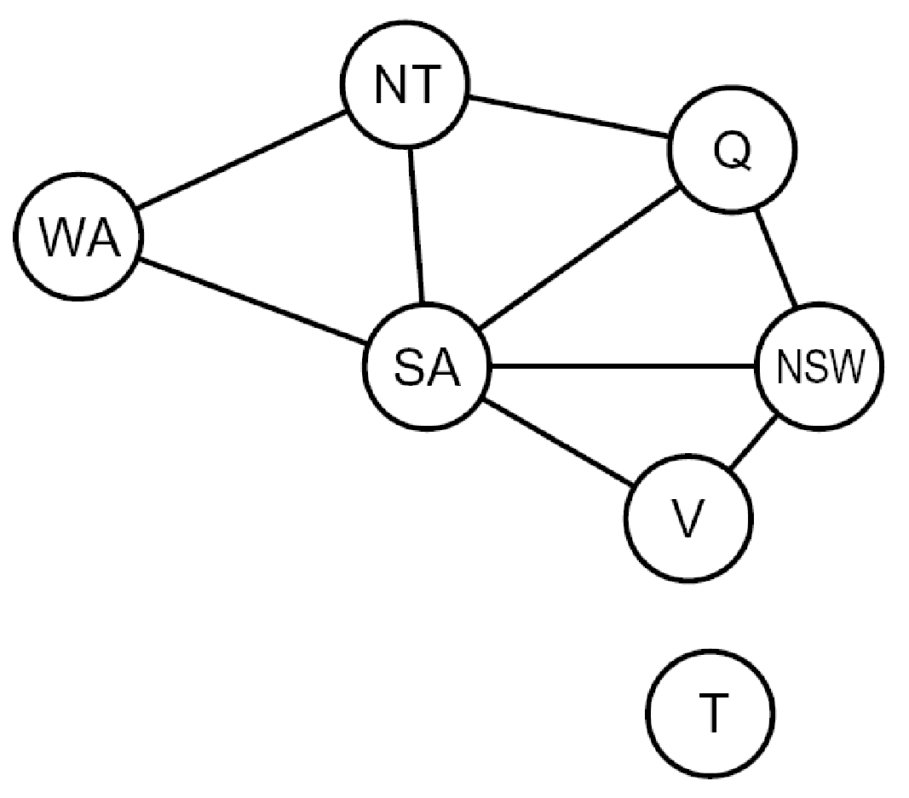
Problem Structure
Extreme case: independent subproblems
Example: Tasmania and mainland do not interact
Independent sub problems are identifiable as connected components of constraint graph
Suppose a graph of n variables can be broken into sub problems of only c variables:
Worst-case solution cost is O((n/c)(d^{c})), linear in n
E.g., n = 80, d = 2, c =20
2⁸⁰ = 4 billion years at 10 million nodes/sec
(4)(2²⁰) = 0.4 seconds at 10 million nodes/sec

Slide 36
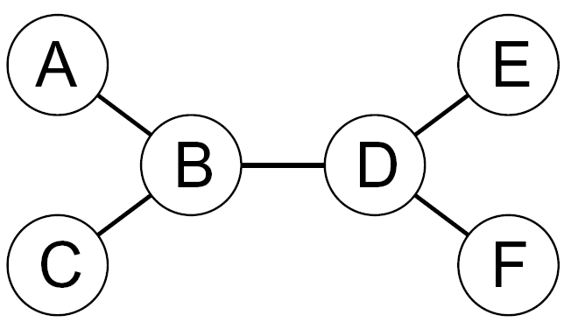
Tree-Structured CSPs
A constraint graph is a tree when any two variables are connected by only one path.
Directed arc consistency (DAC)
A CSP is defined to be directed arc-consistent under
an ordering of variables X1,X2, . . . ,Xn if and
only if every Xi is arc-consistent with each Xj for j > i.

Slide 37
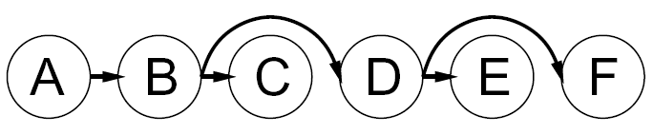


Tree-Structured CSPs
Algorithm for tree-structured CSPs:
Order: Choose a root variable, order variables so that parents precede children (topological sort)
Remove backward: For i = n : 2, apply RemoveInconsistent(Parent(X_{i}),X_{i})
Assign forward: For i = 1 : n, assign X_{i} consistently with Parent(X_{i})
Runtime: O(n d²) (why?)
Notes:
n-1 arcs
d values for the two variables of each arc.

Slide 38
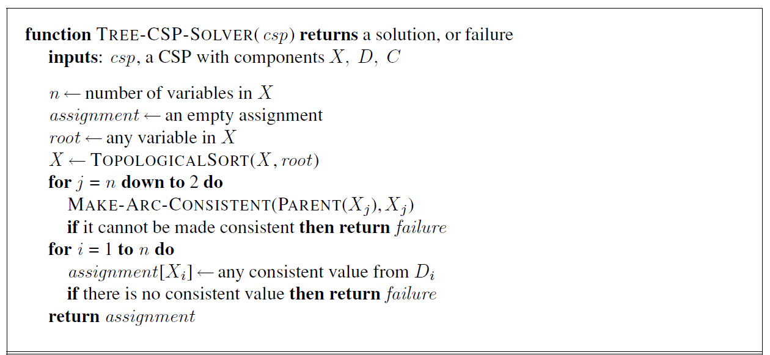
Tree CSP Solver
Notes:
No backtracking.
Since each link from a parent to its child is arc consistent, we know that for any value we choose for
the parent, there will be a valid value left to choose for the child. That means we won’t have
to backtrack; we can move linearly through the variables.

Slide 39
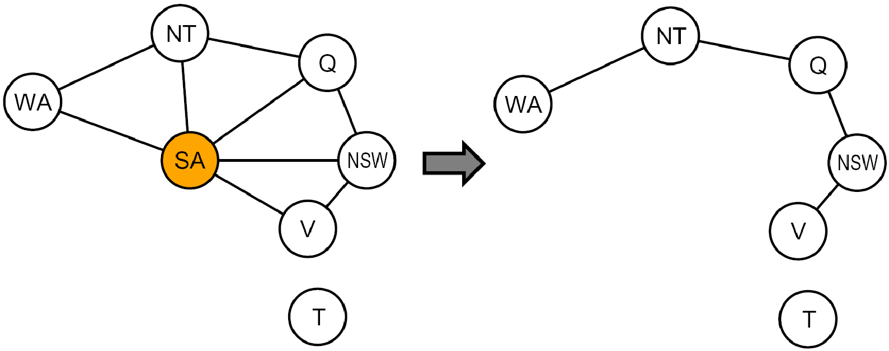
Nearly Tree-Structured CSPs
Conditioning: Assign a value to a variable (SA), prune its neighbors' domains
Cutset conditioning: instantiate (in all ways) a set of variables such that the remaining constraint graph is a tree
Cutset size c gives runtime O( (d^{c}) (n-c) d² ), very fast for small c

Slide 40







Cutset Conditioning
Choose a cutset
SA
Instantiate the cutset (all possible ways)
SA
SA
SA
Compute residual CSP for each assignment
Solve the residual CSPs (tree structured)

Slide 41
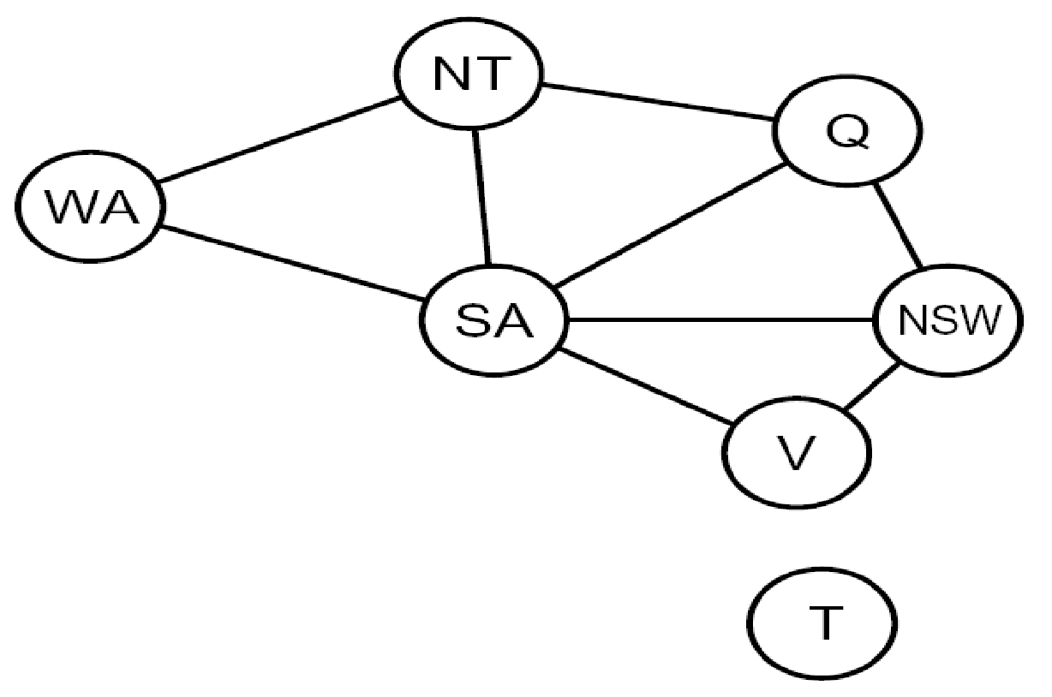
Tree Decomposition
Idea: create a tree-structured graph of mega-variables
Each mega-variable encodes part of the original CSP
Subproblems overlap to ensure consistent solutions
M1
M2
M3
M4
WA
≠
NT
NT
≠
Q
Q
≠
NSW
NSW
≠
V
≠
≠
≠
≠
≠
≠
≠
≠
SA
SA
SA
SA
Agree on shared vars
Agree on shared vars
Agree on shared vars
{(WA=r,SA=g,NT=b),
(WA=b,SA=r,NT=g),
…}
{(NT=r,SA=g,Q=b),
(NT=b,SA=g,Q=r),
…}
Agree: (M1,M2) ∈
{((WA=g,SA=g,NT=g), (NT=g,SA=g,Q=g)), …}

Slide 42
Tree Decomposition
A tree decomposition must satisfy the following three requirements:
Every variable in the original problem appears in at least one of the subproblems.
If two variables are connected by a constraint in the original problem, they must appear
together (along with the constraint) in at least one of the subproblems.
If a variable appears in two subproblems in the tree, it must appear in every subproblem
along the path connecting those subproblems.
A given constraint graph admits many tree decompositions; in choosing a decomposition, the aim is to make the subproblems as small as possible.

Slide 43
Tree Decomposition
Each subproblem is solved independently; if any one has no solution, we know the entire
problem has no solution.
If we can solve all the subproblems, then we attempt to construct a global solution as follows:
1. We view each subproblem as a “mega-variable” whose domain is the set of all solutions for the subproblem
2. We solve the constraints connecting the subproblems, using the efficient algorithm for trees given earlier.
The constraints between subproblems simply insist that the subproblem solutions agree on their shared variables.
For example, given the solution {WA = red ,SA = blue,NT = green} for the first subproblem, the only consistent solution for the next subproblem is {SA = blue,NT = green,Q = red}.

Slide 44
Local Search for CSP
Local search algorithms turn are effective in solving many CSPs.
They use a complete-state formulation: the initial state assigns a value to every variable, and the
search changes the value of one variable at a time.
The initial state violates several constraints, so local search tries to eliminate the violated constraints.
Local search uses the min-conflicts heuristic for choosing a new value for a variable.
The min-conflicts heuristic results in the minimum number of conflicts with other variables.

Slide 45
Local Search for CSP
Constraint Weighting can help concentrate the search on the important constraints.
Each constraint is given a numeric weight, Wi, initially all 1.
At each step of the search, the algorithm chooses a variable/value pair to change that will result in the lowest total weight of all violated constraints.
The weights are then adjusted by incrementing the weight of each constraint that is violated by the current assignment.
This adds weight to the constraints that are proving difficult to solve.

Slide 46
Local Search for CSP
Local search can be used in an online setting when the problem changes.
For example, a week’s airline schedule may involve thousands of flights, but bad weather at one airport can render the schedule infeasible.
We would like to repair the schedule with a minimum number of changes.
This can be easily done with a local search algorithm starting from the current schedule.
On the other hand, a backtracking search with the new set of constraints usually requires much more time and might find a solution with many changes from the current schedule.

Slide 47
Summary
CSP Formulation
Backtracking Search
Improving backtracking search
Variable and value ordering
Forward checking
Constraint Propagation
Arc Consistency
Problem Structure
Local Search for CSP

